Slide 1
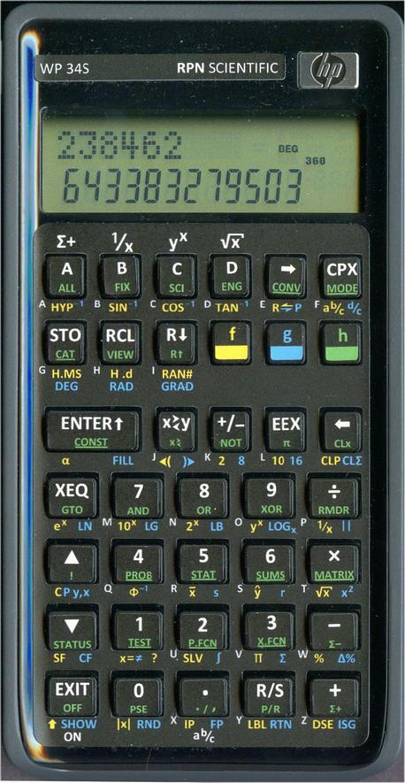
The WP-34S and the “HP Calculator Way”
Jake Schwartz

Slide 2
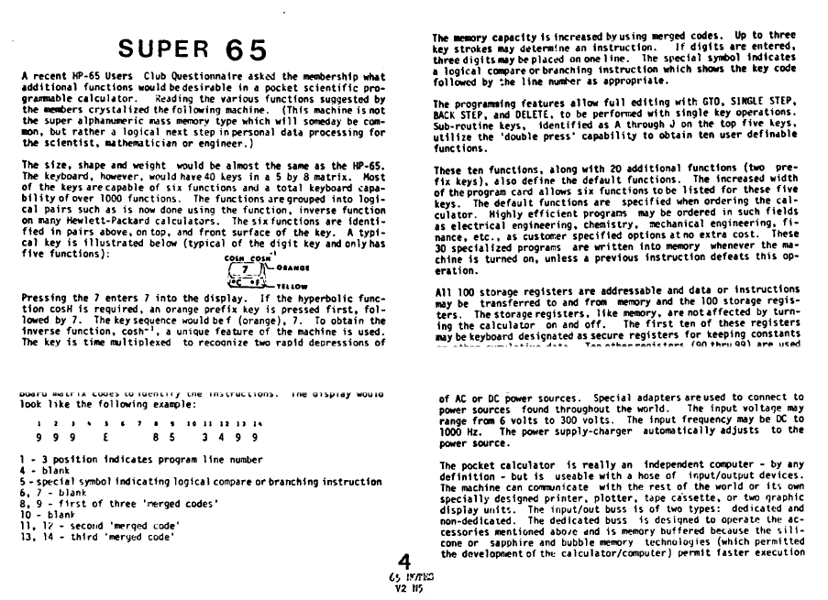
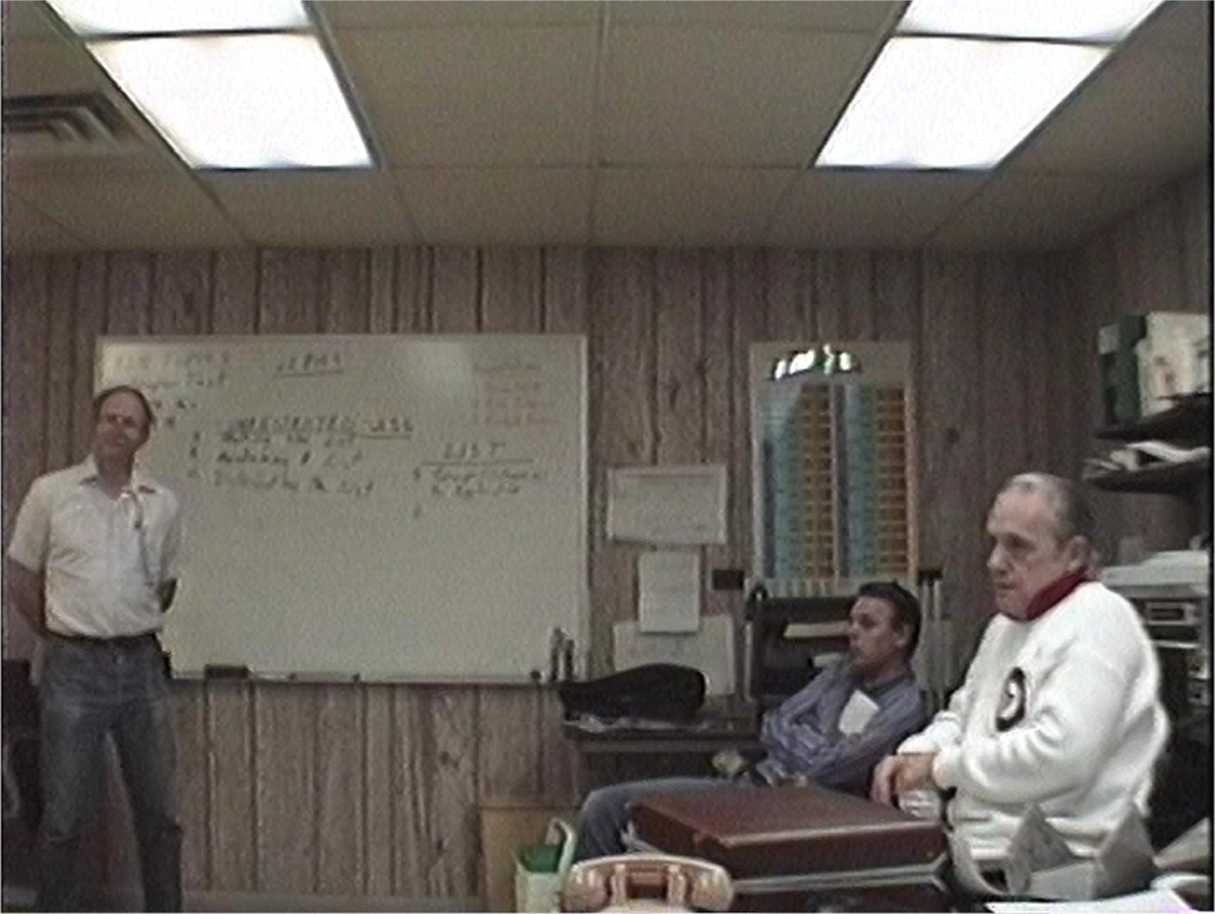
Two of enthusiasts’ favorite things have been Wish Lists and What-Makes-HP-Different/Better lists
HP65 Notes V2N5 From June, 1975 Richard Nelson, Paul Hubbert, Bob Bradley discuss what makes
HP machines superior at ACE Metal Crafts (Melrose Park, IL) at
the CHIP meeting on 6/6/90 following the 1990 PPC Conference
at HP’s facility in Rolling Meadows, IL. Also attending were Brian
Walsh, Jake Schwartz and Ron Johnson.

Slide 3
Typical Wish-list Items
Faster
More program/data memory
Longer battery life
More expandability
More I/O
More customizability
Bigger screen
More compact (?)

Slide 4
Typical Differentiators
RPN/RPL (Firmware / FW)
Large ENTER key (Hardware / HW)
Hardware build quality (HW)
Key feel (HW)
Readable screen (HW)
Better Accuracy (FW)
Better Documentation (Doc)
Ease of Use (FW)
Keystroke Efficiency (FW)
Expansive function set (FW)
Programming language (FW)
Customizability (FW)
Well thought-out feature set (FW)

Slide 5
HP and The Community’s Vision Diverges
Features→
“The Crossover
Point”
HP
Users
HP 35
HP 65
HP 67
HP 41
HP 42
HP 48
HP 49
HP 35S
Time→
(not necessarily
To scale)
HP 50
HP proudly announces new
and exciting things at
conferences
The user community presents
ideas and suggestions to HP
at conferences

Slide 6
Disposal of the Original HP “Family Jewels”
Prior to the “crossover point”, HP produced “disruptive” calculators, surprising the community and leading with new unexpected and powerful features. Their goals were beyond our expectations.
After the crossover point, HP’s goals began to change due to various factors:
Complex problem solving (and thus the professional users) transitioning to other platforms
Perceived different market (i.e. education) requiring neither state-of-the-art firmware nor hardware built to last a lifetime
Comprehensive documentation considered a “nice to have” rather than a “must”
Cost cutting due to lower profit expectations

Slide 7
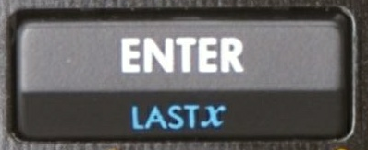
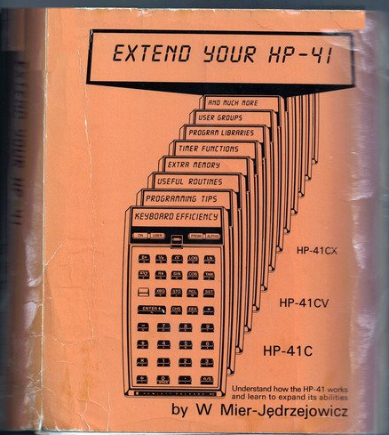
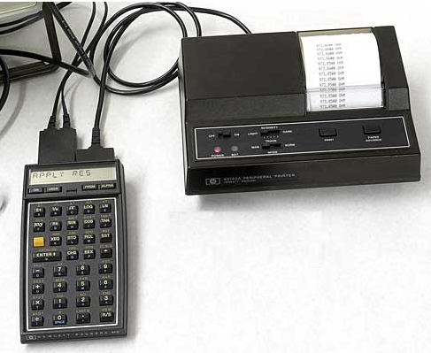
“We Still Want It All!!”
For the diehards, our goals have continued upward at a higher pace than “economic reality”:
“Bulletproof” hardware is still important
“Smarter” firmware is demanded
Maximize functionality, flexibility and keystroke efficiency
Retain some form of ENTER/RPN/RPL for
“back-of-the-napkin” calculations
Manuals / reference material documenting
“everything” and more
Comms with the world
is a must

Slide 8
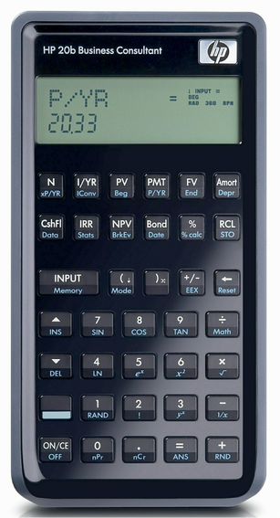
How Did The Community Keep On Keepin’ On?
Thanks to Cyrille, Tim and the HP team, the 20b/30b financial models could be repurposed with replacement firmware
Thanks to Walter Bonin, Paul Dale, Marcus Von Cube and the “gang” over at the HP Museum Forum, the WP34S was born and raised

Slide 9
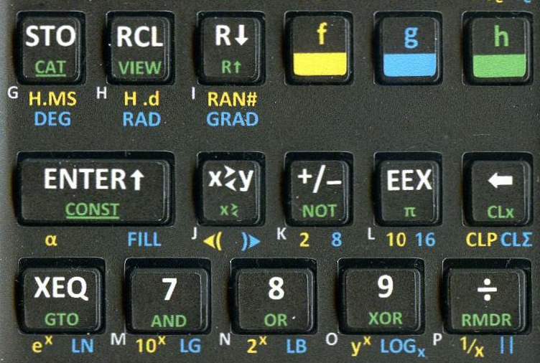
Achievements of the WP-34S
The ‘34S implemented:
Vast function arsenal: 42S + 16C + much more
HP RPN-style programming language with many extensions
Relative ease of use
Multiple function shifts resulting in
good keystroke efficiency
Incredible speed due to fast CPU
Four user keys facilitated for limited
custom usage
Higher accuracy and dynamic range
than any handheld in its “class”
Firmware to handle optional crystal for accurate timer
Firmware to handle optional IR LED for printing to HP thermal printer
Crash-resistant memory backup space, memory for program banks

Slide 10
Limitations of the WP-34S (Understandably due to HP’s design goals of the platform as a inexpensive financial calc)
The LCD has a very limited dot matrix on one line with segment display on the other line
Prevents allowing true soft keys a la
42S/17BII+/50g
Limited information may be shown at one time
Relatively small memory on board with no easy expandability via plug-ins
No native “standard” I/O and we have run out of custom firmware-upgrade cables
No beeper
Keys/keyboard must be manually modified with adhesive labels

Slide 11
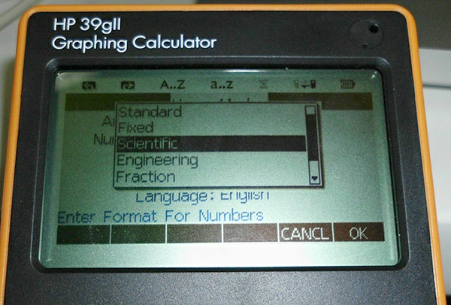
Where Do We Go From Here?
The HP39gII is the latest HP platform, which is significantly more powerful than the 20b/30b system and has a very high resolution display
If repurposing is achievable, a great deal could be done
The other “homebrew” community project might bear fruit soon, providing great promise……Eric S. & Richard O.??

Slide 12
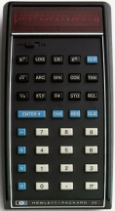
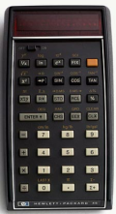
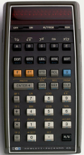
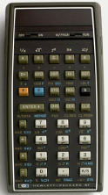
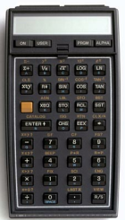
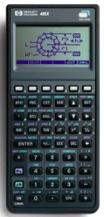
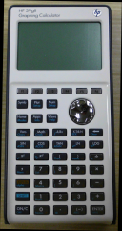
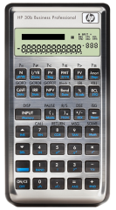
The Evolving March Toward the Future
Repeated
Keystroke
Sequence
Calculator
User
Program
Custom
Module /
Applet/Library
Custom
Calculator
Firmware
Custom
Calculator
From Scratch
HP35 & all others
HP65 /67 /41 & later programmables | HP65 /67 /41 & later programmables
HP41C/CV/CX, 38/39/40, 48/49/50 | HP41C/CV/CX, 38/39/40, 48/49/50 | HP41C/CV/CX, 38/39/40, 48/49/50
HP20b/30b WP-34S | HP20b/30b WP-34S | HP20b/30b WP-34S | HP20b/30b WP-34S
DIY - X | DIY - X | DIY - X | DIY - X | DIY - X
DIY-X???

Slide 13
HP and the Advanced User Community
HP and the calculator “lunatic fringe” probably are permanently on different paths from here on in
We likely are going to have to do it ourselves from now on and it will continue to have to be labors of love
The WP-34S team worked miracles and showed how it could be done – Bravo!!
Monte Dalrymple’s 41CL is another example of serious homebrew magic
We look forward to the “Next Great Ride”

